Slide 1
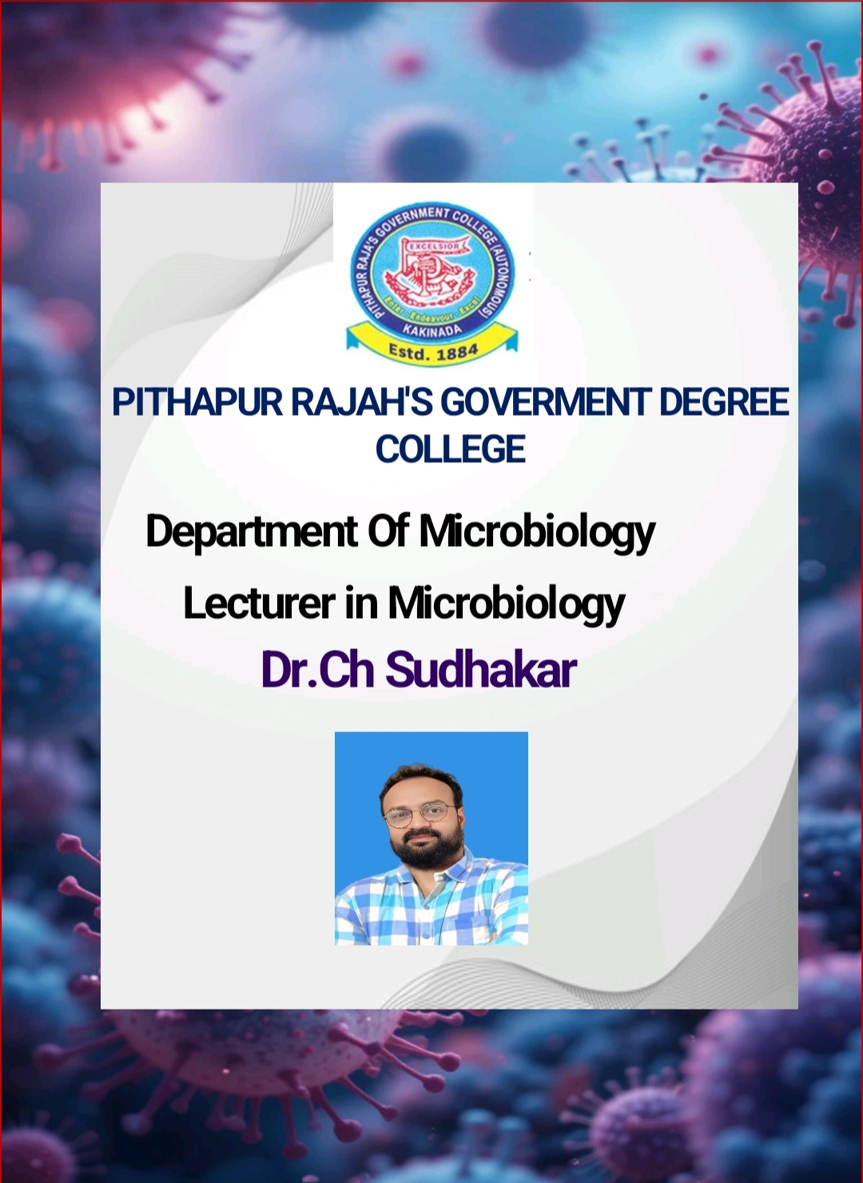

Slide 2
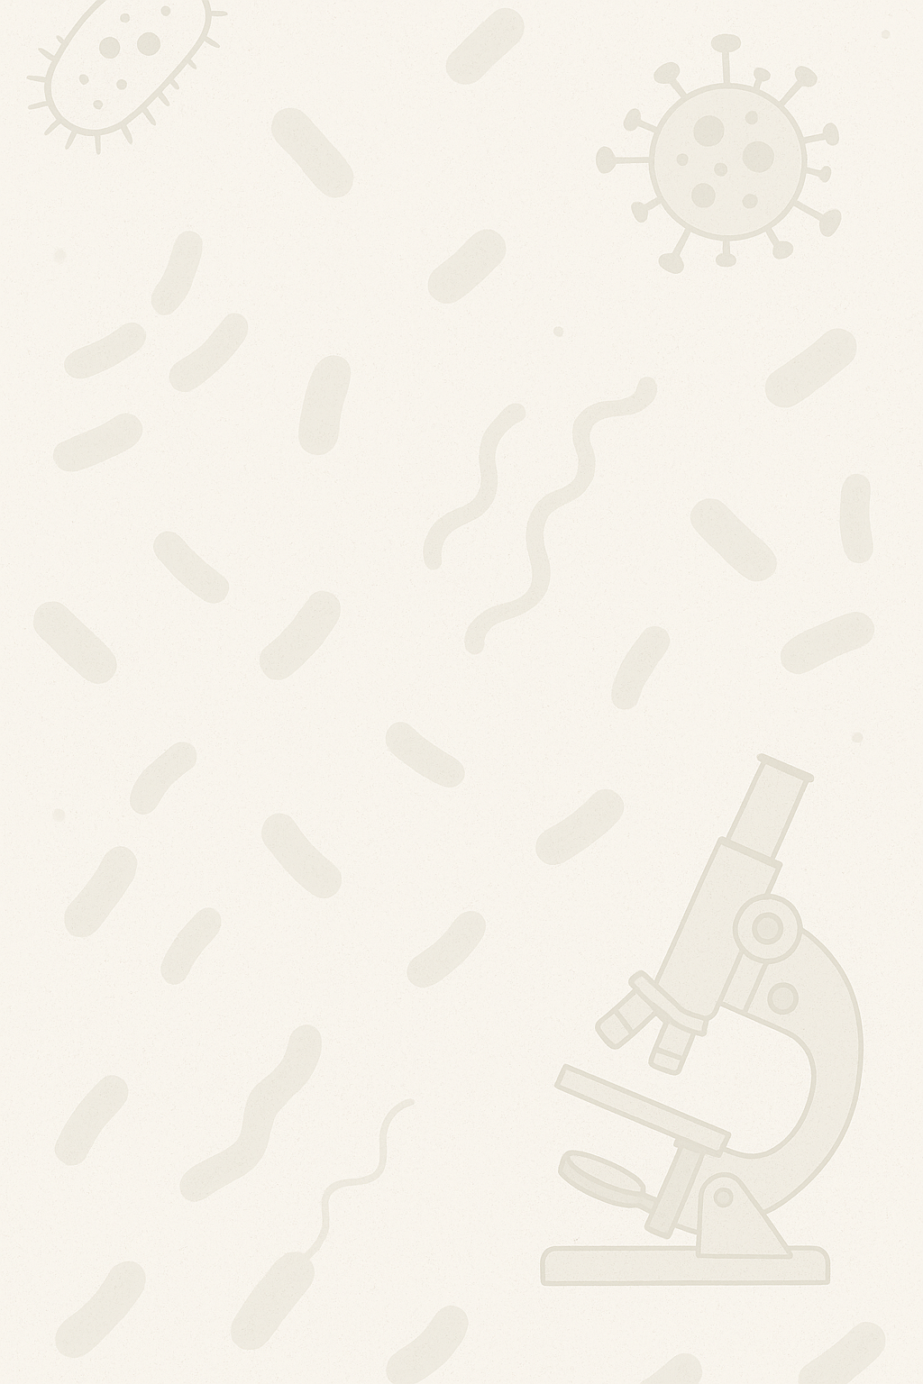
TITLE: INTRODUCTION TO MICROBIOLOGY
UNIT - 4
Growing Microbes in Lab: Five I’s

Slide 3
Introduction – The Five I’s of Microbiology
1. The Five I’s help in growing, observing, and identifying microorganisms in the lab.
2. The steps are:
Inoculation
Incubation
Isolation
Inspection
Identification
3. These steps help in obtaining pure cultures for study.
4. Commonly used in medical, industrial, and research labs.
5. Requires sterile (aseptic) techniques to avoid contamination.

Slide 4
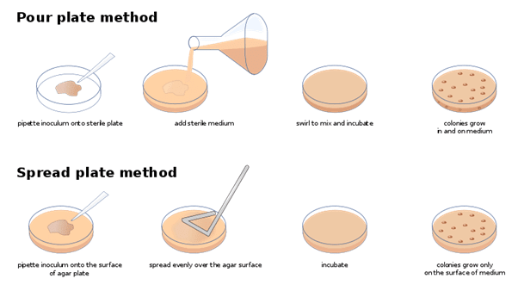
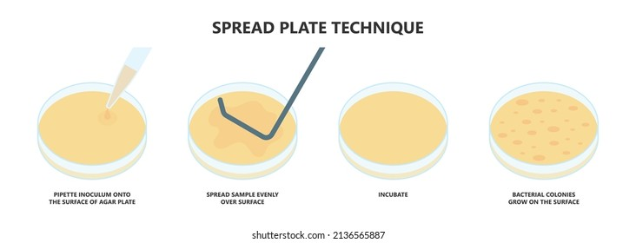
Inoculation
1. Inoculation = Introduction of microorganisms (inoculum) into growth media.
2. Aseptic technique is used to prevent contamination.
3. Tools: inoculating loop, needle, pipette.
4. Media types:
Solid media (e.g., agar plates)
Liquid media (e.g., nutrient broth)
5. Media provides nutrients for microbial growth.

Slide 5
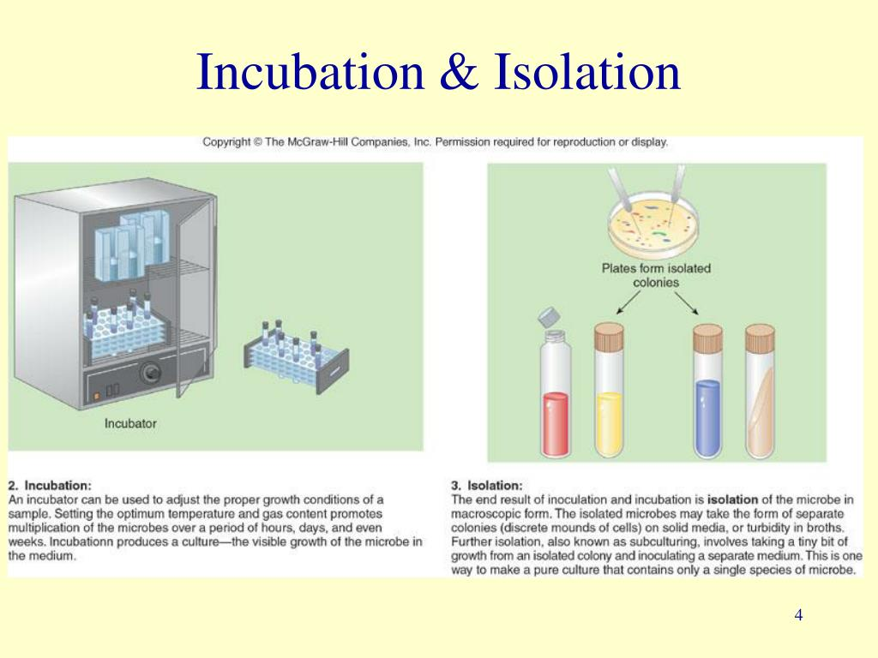
Incubation and Isolation
1. Incubation = Keeping cultures at suitable temperature for growth.
2. Common temperature: 25–37°C, depending on organism.
3. Isolation = Separation of individual microbes from a mixed culture.
4. Techniques: streak plate, pour plate, spread plate.
5. Types of cultures:
Pure culture – only one type of microbe
Mixed culture – more than one type
Contaminated culture – unwanted microbes present

Slide 6
Inspection
1. After incubation, cultures are inspected visually.
2. Observations include:
Colour of colonies
Size and shape
Texture and elevation
3. Helps in early identification of microbes.
4. Growth pattern in liquid media also observed.
5. Note changes like turbidity, sediment, or surface growth.

Slide 7
Identification
1. Involves simple lab techniques to identify microbes.
2. Wet mount: Fresh preparation of microbial cells in water.
3. Simple staining: Use of a single dye (e.g., methylene blue) to see shape and size.
4. Identification based on:
Shape (cocci, bacilli, etc.)
Arrangement (chains, clusters)
5. Final step in diagnosing and studying microbes.

Slide 8
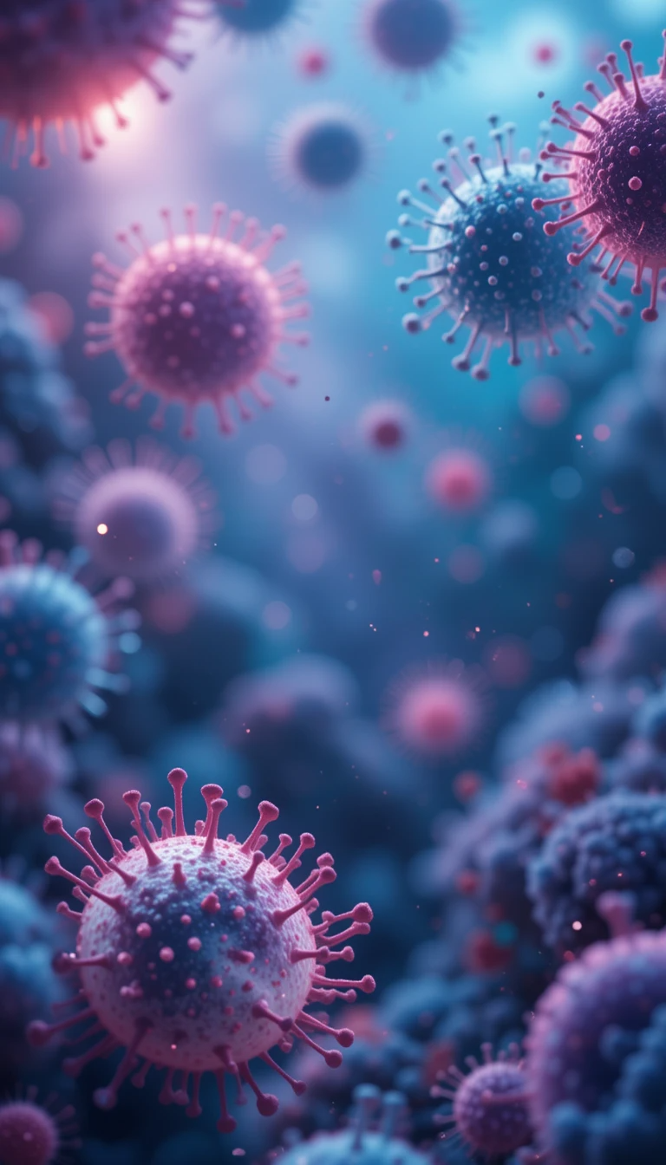

THANK YOU

